Slide 1
Automated Program Repair: Concepts, Techniques, and Challenges
Dr. Damian A. Tamburri, University of Sannio & JADS

Slide 2
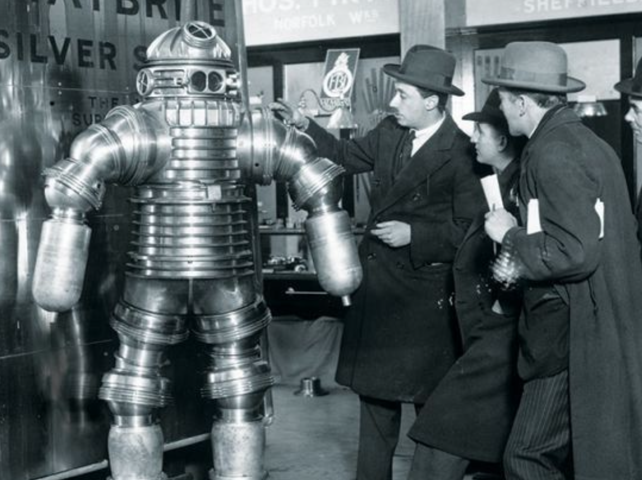

Slide 4
1. Motivation and Context
• Software maintenance consumes up to 90% of total cost (Lientz & Swanson, 2010)
• Automated Program Repair (APR) aims to reduce human debugging effort
• Goal: search for a bug fix = a code transformation that makes tests pass again;
• Goal: Improve software quality, reliability, and sustainability;

Slide 5
2. What is Automated Program Repair?
• Process of automatically modifying software to remove defects
• Two key paradigms:
– Generate-and-validate (search-based)
– Semantics-based (symbolic / constraint solving)
• Example: GenProg automatically evolves candidate patches

Slide 6


Monperrus The Sage*!
* Martin Monperrus. The Living Review on Automated Program Repair. [Technical Report] hal-
01956501, HAL Archives Ouvertes. 2018. hal-01956501v6

Slide 7
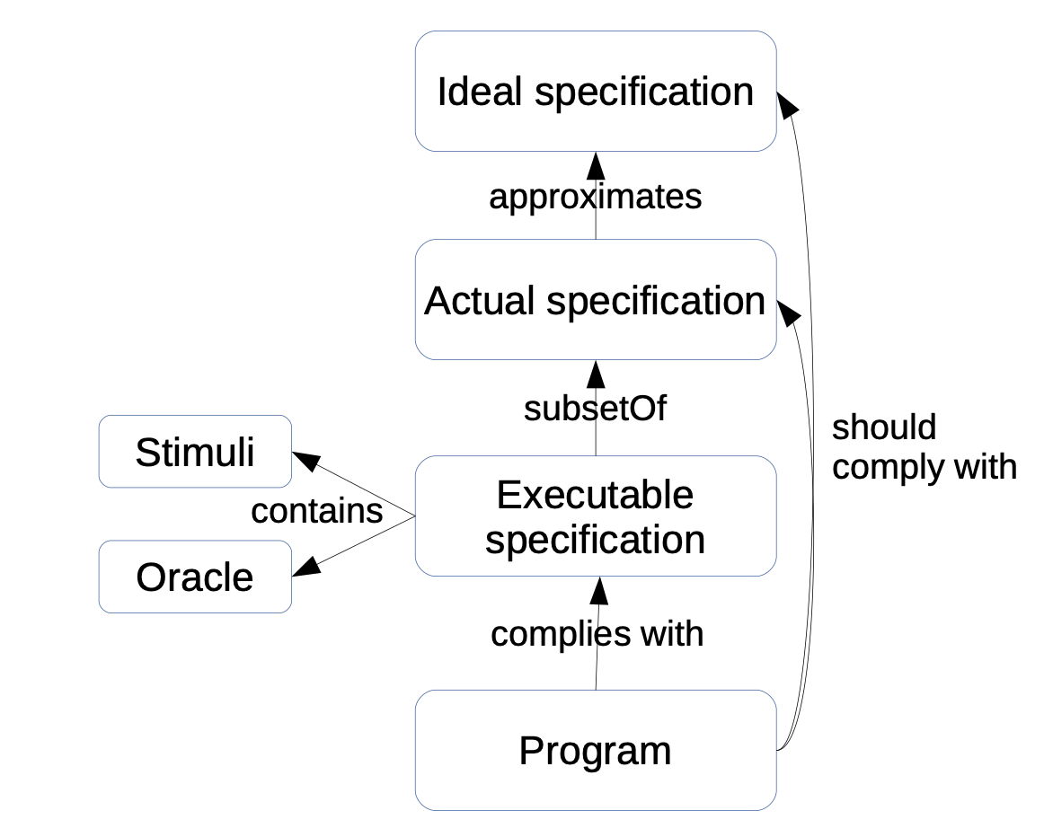

Slide 8
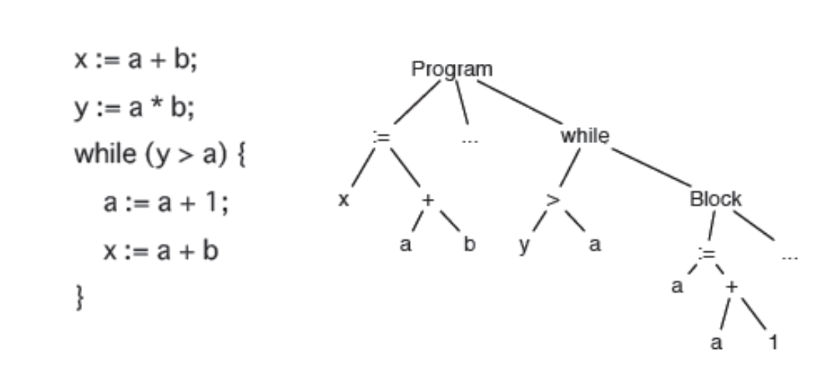
The enemy abstraction…

Slide 9

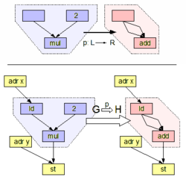
1. Find a buggy SLOC
2. Find a fix F
3 – ITERATE: Given a spec, find a graph rewriting rule that changes bug statement into bug-free statement with the fix F.

Slide 10
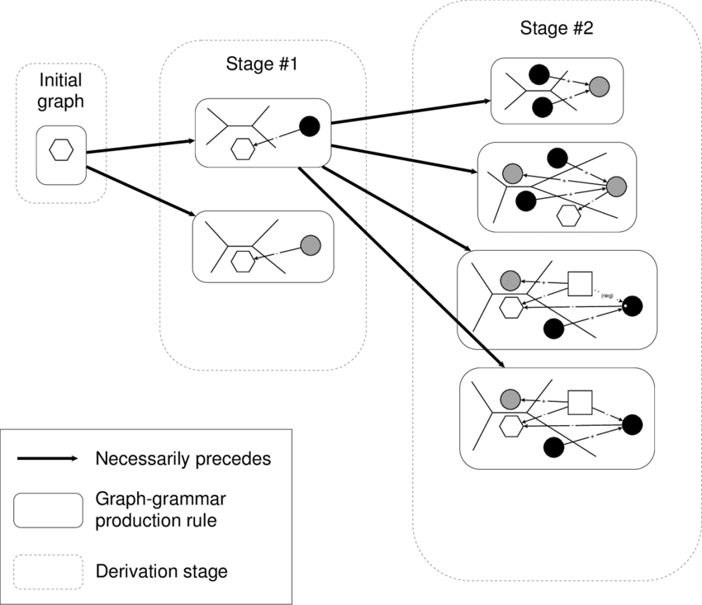
But…
Too complex
Implies formal specification
Graph grammars!

Slide 11

What do we do?

Slide 12
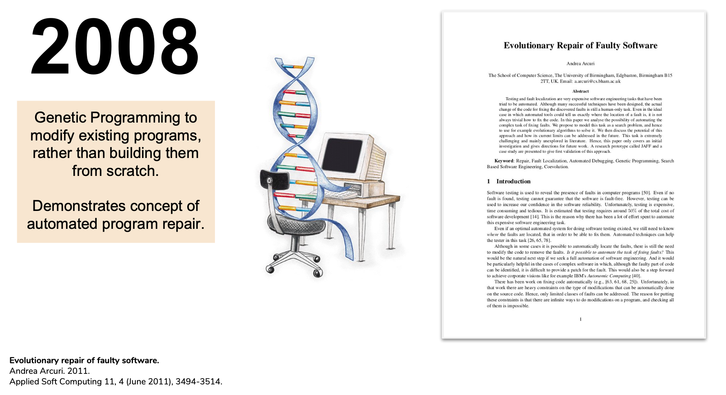

Slide 13
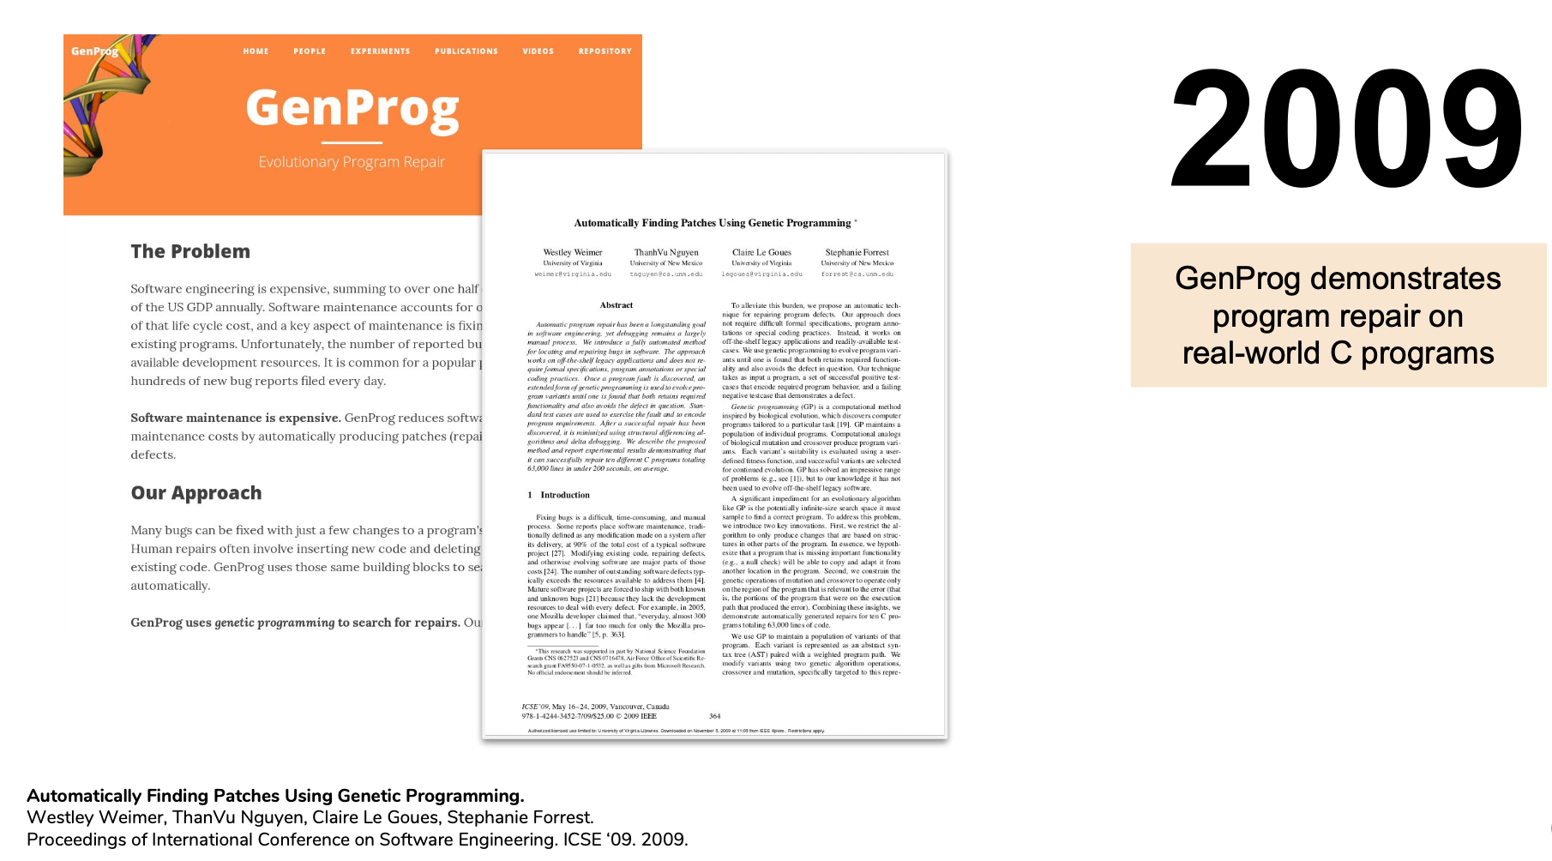

Slide 14
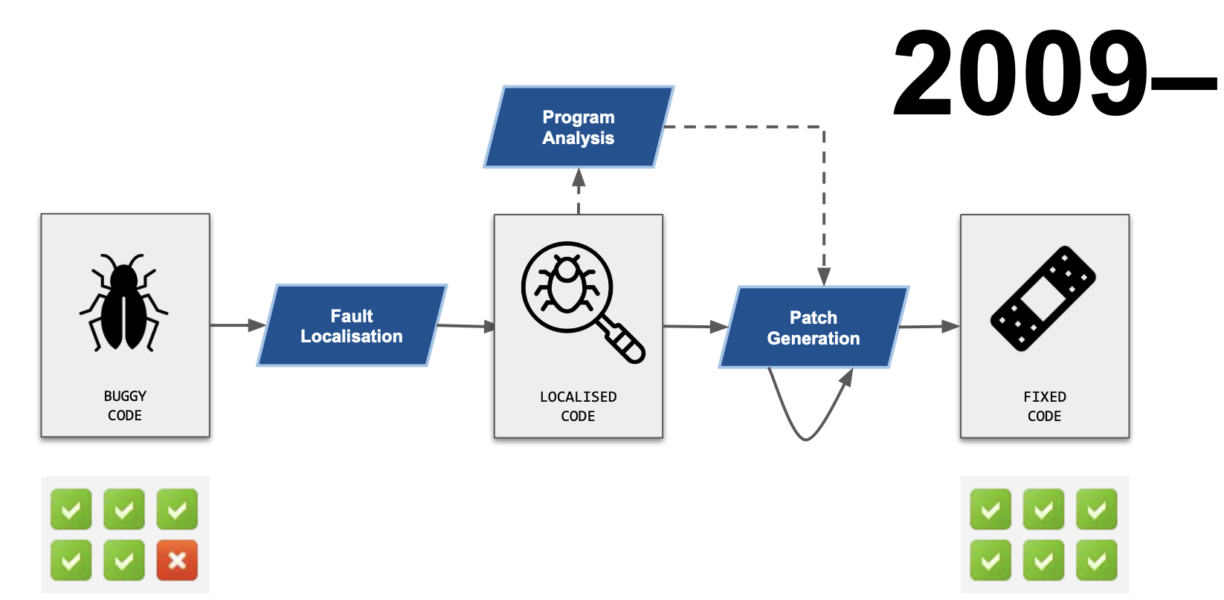

Slide 15
Premises for Automated Program Repair (APR)
Many security bugs follow common patterns.
E.g., “p = malloc(n * sizeof(T))” where n is attacker-controlled.
Integer overflow ⟹ too little memory gets allocated.
By recognizing such a pattern, it is possible to confidently guess the developer's intention (the inferred specification).
E.g., “Try to allocate enough memory to hold n objects of type T.”
It is possible to repair the code to satisfy this inferred spec.
E.g., check if overflow occurs; if so, simulate malloc failing with ENOMEM.
Other approaches also exist
GenProg (Le Goues et al.) – Genetic algorithm to search for a modification that causes all test cases to give desired behavior.

Slide 16
Outline
Repairs for three types of bugs:
Integer overflow leading to memory corruption.
Static analysis
Missing memory bounds checks.
Static analysis and dynamic analysis
Missing authorization checks in a client-server application.
Heavyweight formal methods

Slide 17
Integer Overflow
Integers in C are represented by a fixed number of bits N.
Overflow occurs when the result cannot fit in N bits.
Modular arithmetic: Only the least significant N bits are kept.
How does integer overflow lead to memory corruption?
Memory allocation: malloc(∙).
Bounds checks for an array.
Example: Android Stagefright bugs (July 2015).

Slide 18
Experimental Results
Xi Wang et al., OSDI 2012
 | Overflows reported by Kint | Overflows that are sensitive | Overflows fully repaired | Semi-repair | Unrepaired
OpenSSL | 969 | 233 | 180 | 28 | 25
Jasper | 481 | 101 | 53 | 32 | 16
(1.0.2g)
An overflow is sensitive iff it involves variables associated with array indices or bounds.
Some of the ‘repairs’ are actually false positives (i.e., operation never overflows). Then our ‘repair’ just adds a little overhead. It never breaks working code.
Others are known vulnerabilities with CVEs and patches.

Slide 19
Repair Strategy
Inferred specification: inequality comparisons involving array indices or bounds should behave as in normal arithmetic (not modular arithmetic).
Includes malloc.
Excludes crypto and hashing functions.
“%” operator does not propagate sensitivity.
Repair: General case is intractable (with bounded memory).
Special case that we handle: non-negative integers with only addition or multiplication (no subtraction or division).
The value is monotonically non-decreasing (except for multiplication by zero).
Normal arithmetic can be emulated using saturation arithmetic:
Replace an overflowed value with greatest representable value (SIZE_MAX).
Assumes all values in calculation are of the same type.
Memory-related integers should be of type size_t; promote up if smaller.

Slide 20
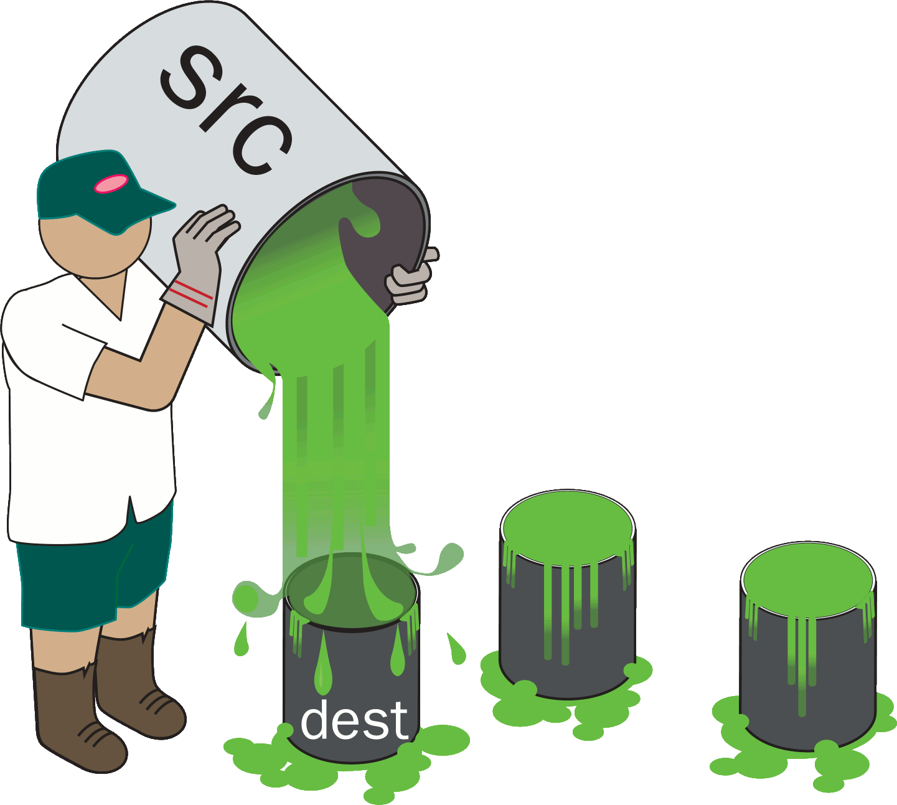
Arithmetic for Checking Bounds of an Array
Example: copy n bytes from src to dest, starting at index start of dest.
Repair: UADD(start, n) /* defined on next slide */
if (start + n <= dest_size) { memcpy(&dest[start], src, n); } else { return -EINVAL; }

Slide 21
wrappers.h
inline static size_t UADD(size_t lop, size_t rop) {
size_t result;
bool flag = __builtin_add_overflow(lop, rop, &result);
if (flag) {result = SIZE_MAX;}
return result;
}
What if dest_size is SIZE_MAX?
What if both sides of inequality overflow?
What if overflow reaches a non-comparison sink?
Repair: UADD(start, n)
if (start + n <= dest_size) { memcpy(&dest[start], src, n); } else { return -EINVAL; }

Slide 22
Semi-Repair
Example adapted from CVE-2015-8370:
unsigned cur_len = 0;
while (1) {
key = grub_getkey();
if (key == ‘\b’) {
if (cur_len == 0) {
/* FIXME: Insert error- handling code here. */
}
cur_len--;
grub_printf(“\b”);
continue;
}
if (cur_len + 2 < buf_size) {
buf[cur_len++] = key;
grub_printf(“%c”, key);
}
}
If a potentially overflowed value is used to index into an array, do a semi-repair.
Tool inserts check for overflow. User writes error-handling code.
semi-
repair

Slide 23
Repair on source vs a compile-time pass
A difficulty we encountered was the Source↔IR mapping problem:
Code is most readily analyzed and repaired on a suitable intermediate representation (IR).
Transformations on the IR aren’t unambiguously mappable to the source.
Macros and #ifdefs are a further difficulty.
We are further investigating these issues this year (FY17).

Slide 24
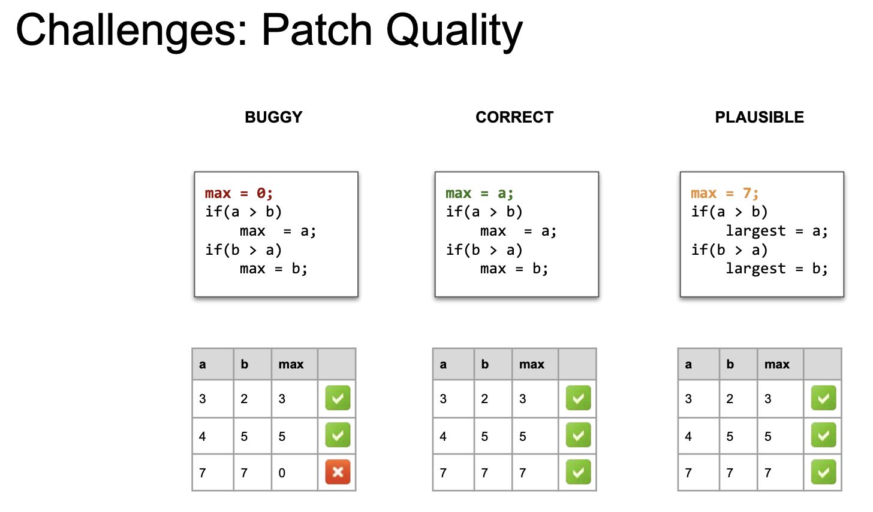

Slide 25
Challenges: approaches are bug-type specific
E.g., security bugs, fixes are in the commit-spec
Bugs tend to be in the CWE lists and similar
Specs are ISO-std compliant

Slide 26
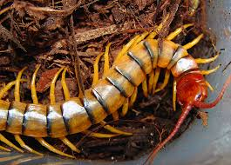
How about our beloved concurrency bugs?

Slide 27
Everyone Needs to Find Concurrency Bugs
Multicore era is coming already here
Programmers struggle to reason about concurrency
More and more concurrency bugs
Many concurrency bugs can be automatically detected
But bugs need to be fixed
Thread 1
Thread 2
if (ptr != NULL) {
ptr->field = 1;
}
ptr = NULL;
Segmentation Fault
2
Notes:
As we all know, multicore era is already here. But programmers still struggle to reason about concurrency. As a result, programmers make more and more synchronization mistakes, and software contains more and more concurrency bugs.
To help this situation, people have developed many ways to detect and diagnose concurrency bugs. For this atomicity violation, which is a common type of concurrency bug, a lot of tools can tell you that if the null pointer assignment happens in between the if checking and the pointer dereference, the program will have segmentation fault.
These tools are helpful for programmer to find and understand bugs. But they still leave the task of fixing to the programmers.

Slide 28
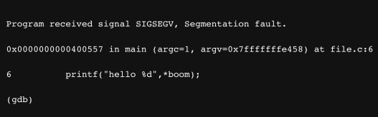

Slide 29
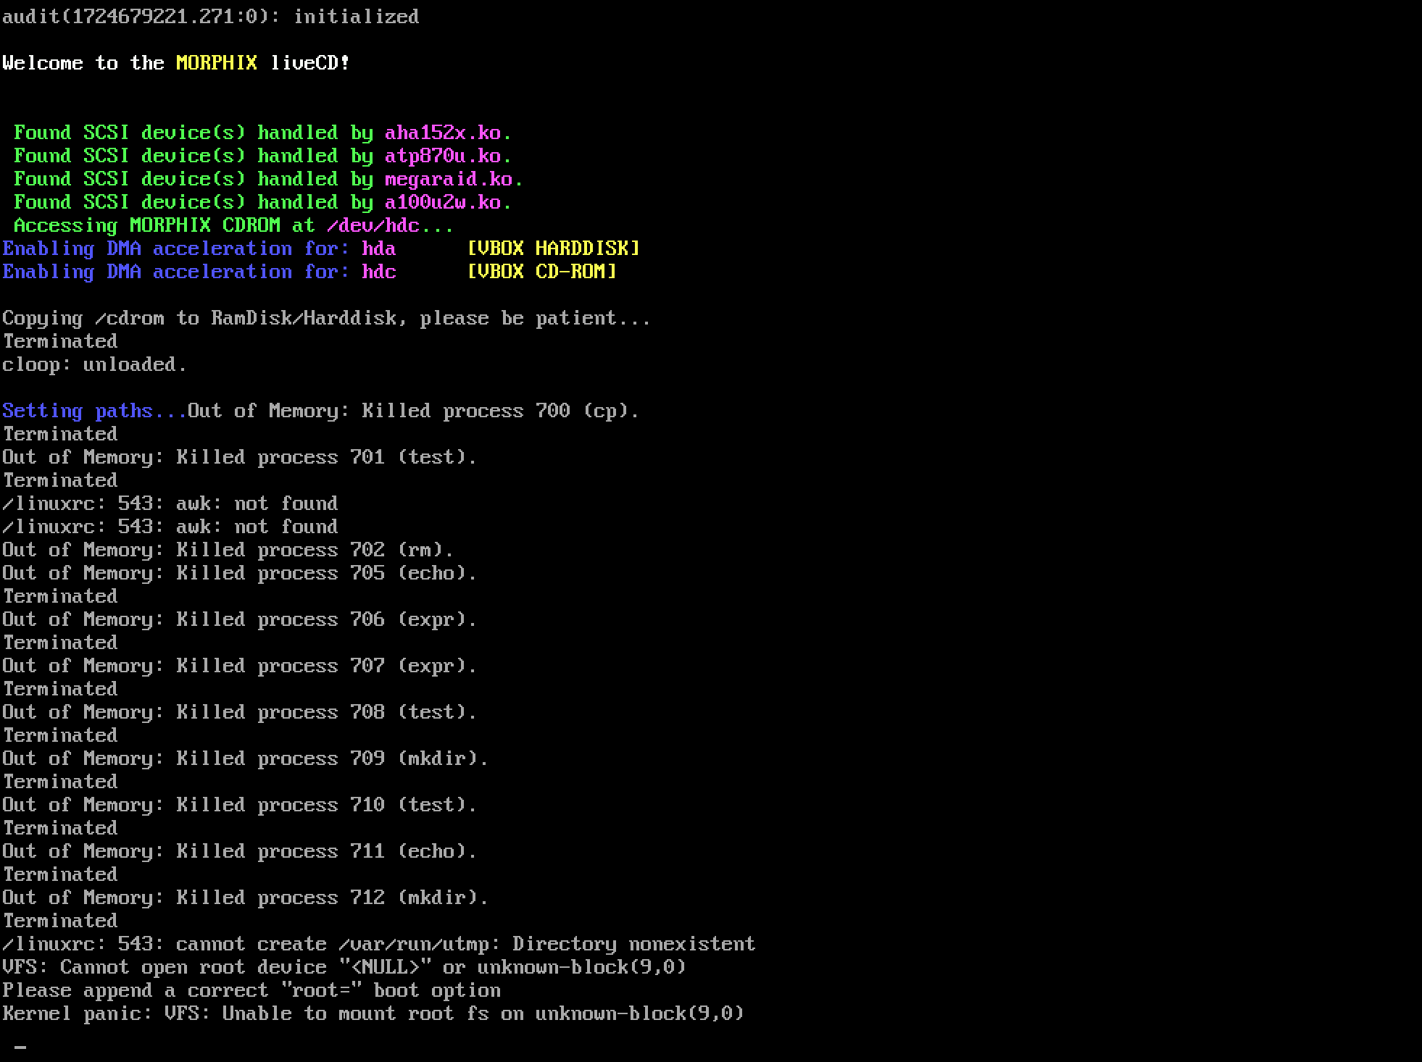

Slide 30
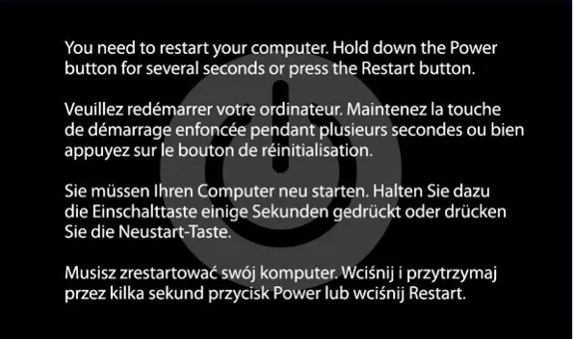

Slide 31
Concurrency Bug-fixing
Process is obv. lengthy and resource consuming
Nearly 70% of patches are buggy in their first releases, ~86% for concurrency bug-fixes;
Automated fixing is desired, but difficult in general;
Understand bug₁
…
…
Understand bug_{n}
Review
& test
the patch
Correctness
Understand a bug
Generate a patch
Performance
Readability
3
Notes:
Bug-fixing is not easy, and it is lengthy and resource consuming. People first need to understand a bug, then generate a patch for it, and finally test the patch to make sure it fixes the problem while maintain performance and readability. Very often, people also need to consider several bugs and fix them together.
Bug-fixing process is also error-prone, some study shows 70% of patches are buggy in their first release.
Given these, a tool that can automatically fix bugs is desired, but this is difficult in general because for most bug, it is difficult to automatically figure out what is the correct behavior.

Slide 32
Automated Concurrency-Bug Fixing
Concurrency bugs are feasible to be fixed automatically
Program is correct in most interleavings.
Only need to remove some bad interleavings.
Thread 1
Thread 2
Thread 1
Thread 2
if (ptr != NULL) {
ptr->field = 1;
}
ptr = NULL;
if (ptr != NULL) {
ptr->field = 1;
}
ptr = NULL;
Thread 1
Thread 2
if (ptr != NULL) {
ptr->field = 1;
}
ptr = NULL;
Segmentation Fault
4
Notes:
Fortunately, when it comes to multithreaded program, although it’s built-in non-determinism makes it difficult to get right, the non-determinism also makes concurrency bugs feasible to be fixed automatically.
Multithreaded programs are correct under most interleavings like these, and we only need to remove some bad interleaving like this one using some synchronization devices.

Slide 33

AFix: Automated Atomicity-Violation Fixing
Why atomicity-violation bugs?
One of the most common types of concurrency bug
Strategy
Statically adding locks to remove buggy interleavings.
Goal
Automate the whole bug-fixing process
Provides best-effort atomicity-violation patches
Correctness
Performance
Readability
5
Notes:
Now comes Afix, our effort towards that direction. we choose atomicity violation as our starting point, since it is an important type of concurrency bug.
Our main strategy is statically adding locks to remove buggy interleavings.
The goal is to automates the whole bug-fixing process and provides best effort patches in terms of correctness, performance, and code readability.

Slide 34
CTrigger Bug-Detector Review
A single-variable atomicity-violation detection & testing tool
It reports a list of buggy instruction triples
Abbreviated as {(p₁, c₁, r₁), …, (p_{n}, c_{n}, r_{n})}
previous access
Thread 1
Thread 2
​current access
if (ptr != NULL) {
ptr->field = 1;
}
​remote access
ptr = NULL;
7
Notes:
CTrigger is a single-variable atomicity-violation detection and testing framework with almost no false positive. It reports a list of buggy instruction triples.
For this example, ctrigger will report three instructions, and the program will fail when remote access happens in between previous access and current access, short as p, c and r.

Slide 35
AFix Overview
Input from CTrigger
adding runtime support
patch
testing
(p₁, c₁, r₁)
…
...
…
(p_{n}, c_{n}, r_{n})
patch₁
merged
patch₁
…
…
…
…
merged
patch_{m}
patch_{n}
Bug understanding
Patch generation
Patch testing
Manual Bug Fixing Progress
8
Notes:
Starting from a list of pcr triples, Afix first designs patch for each pcr triple, then we use the whole list of pcr triples and patches, merge them using some heuristics, after that, we add runtime support if needed, finally, we provide support to test those patches, so that developers can access the quality of the patches.

Slide 36


(p, c, r) Patching
One Bug Patching
Make the p-c code region mutually exclusive with r
Put p and c into a critical section
Put r into a critical section
Select or introduce a lock for the two critical sections
p
r
c
10
Notes:
We start from one bug patching, or one pcr triple patching.
The overall strategy is making the code region from p to c mutually exclusive with r, and we achieve that using the following three steps:
put p and c into a critical section.
put r into a critical section.
finally, we decide lock type to use, select or introduce a lock instance for the two regions.
This sounds trivial, but there are many pitfalls. Let’s look at each step in detail

Slide 37
Put p and c into a Critical Section: naïve
A naïve solution
Add lock on edges reaching p
Add unlock on edges leaving c
Potential new bugs
Could lock without unlock
Could unlock without lock
etc.
p
p
p
p
c
c
c
c
11
Notes:
To put p and c into a critial section, we need to guarantee that p and c are inside one critical section under all control flows without introducing new bugs.
A naïve solution which adds lock before p and unlock after c, but this could have problems like lock without unlock, unlock without lock, and many other problems along different paths

Slide 38

Put p and c into a Critical Section: AFix
Assume p and c are in the same function f
Step 1: find protected nodes in critical section
In f’s CFG, find nodes on any p → c path
Step 2: add lock operations
unprotected node → protected node
protected node → unprotected node
Avoid those potential bugs mentioned
p
c
12
Notes:
Now let’s take see how afix avoids all of them.
We first assume p and c are in the same function f for now, and we will extend our algorithm when it is not the case.
The first step is to find out all the protected nodes in the critical section. We analysis the control flow graph of the function f, map p and c instruction to basic block nodes in the graph that contain them, and find out the set of control flow graph nodes on any path from the p node to the c node. In this example, we have two paths and three nodes
Based on this set of protected nodes, we add lock acquisition operation on edge from unprotected node to protected node, and lock release on edge from protected node to unprotected node.
With these, we avoid those potential bugs mentioned previously. You can find the detailed proof in our paper.

Slide 39
p and c Adjustment
p and c adjustment when they are in different functions
Observation: people put lock and unlock in one function
Find the longest common prefix of p’s and c’s stack traces
Adjust p and c accordingly
void newlog()
{
…
close();
open();
…
}
void close() {
…
log = CLOSE;
}
void open() {
…
log = OPEN;
}
void newlog()
{
…
p: close();
c: open();
…
}
p:
c:
close()
newlog()
…
open()
newlog()
…
13
Notes:
Now let’s extend the algorithm when p and c are in different functions.
This is very common. In this example from mysql, the function newlog accesses the global variable “log” twice through close and open. Ctrigger reports these two as `p’ and `c’ instructions. Now, we need to put instructions from two different functions into one critical section.
What should we do? AFix’ solution is inspired by the observation that people usually put lock and unlock in the same function.
Afix finds the longest common prefix for both p and c’s calling contexts. It ends with newlog here.
Then we adjust p and c to be the instructions that call to the next function in the call stack, so that they are in the same function now and the algorithm described previously can be used again.

Slide 40
(p, c, r) Patching: put r into a critical section
Lock-acquisition before r, lock-release after r
Only if r cannot be reached from the p–c critical section
fpc() {
lock(L1)
p
...
r
…
c
unlock(L1)
}
case 1
fpc() {
lock(L1)
p
...
foo() {…→r}
…
c
unlock(L1)
}
case 2
r’s call stack: … →fpc →foo →…→r
14
Notes:
The second step is to put r into a critical section.
Simple! Add lock and unlock around r. Well, there is one trap here!
If r could be reached from the p-c critical section, we should not add extra locks for r.
Note there are two ways to reach r from the pc critical section: directly or through function calls. Afix handles both cases.

Slide 41


(p, c, r) Patching: select or introduce a lock
Use the same lock for the critical sections
Lock type:
Lock with timeout : in case of potential new deadlock
Reentrant lock : in case of recursion
Otherwise: normal lock
Lock instance:
Global lock instances are easy to reuse
15
Notes:
Now, we have one or two critical sections. Then we need to decide which lock to use.
It is obvious that we should use the same lock if there are two critical sections
For the lock, we have two properties need to be decided:
The first is lock type: we use lock with timeout when our patch could lead to deadlock. We determine this by checking whether there is potential blocking operations, (such as lock and spin loop) inside the critical sections we added.
We also check whether the lock operations could be called recursively, and use reentrant lock if recursion is possible. In all other cases, we just use normal pthread lock type.
The next is on lock instance. We hope we could reuse some existing locks when possible. But only global lock instances are easy to reuse. We check whether reusable global lock exists.

Slide 42
Patch Merging
One programming mistake can lead to multiple bug reports
They should be fixed all together
p1
c1 p2
r1 c2, r2
void buf_write() {
int tmp = buf_len + str_len;
if (tmp > MAX)
return;
memcpy(buf[buf_len], str, str_len);
buf_len = tmp;
}
p1
c1
p2
Too many lock/unlock operations
Potential new deadlocks
May hurt performance and readability
r1
c2, r2
16
Notes:
Now we have patches for each pcr triple. However, one programming mistake usually leads to multiple bug reports in practice.
Like this real world example. You do not need to understand this piece of code right now. The point here is that the missing lock and unlock operations here lead to two pcr triples from ctrigger, and if they are fixed seperatedly, we are going to add seven lock and unlock operations for these five lines of code, which is too many. It also has a potential deadlock between the two patches. It may also hurt performance and readability.
To solve these problem, these bugs should be fixed together, and we achieve that using patch merging.

Slide 43
Patch Merging: redundant patch
Redundant patch, when p₁–c₁, p₂–c₂ critical sections
are in the same function: redundant when one protected region is a subset of the other
are in different functions: consulting the stack trace again
lock(L1)
p1
lock(L2)
p2
c2
unlock(L2)
c1
unlock(L1)
lock(L1)
p1
p2
c2
c1
unlock(L1)
lock(L1)
r1
unlock(L1)
lock(L2)
r2
unlock(L2)
lock(L1)
r2
unlock(L1)
17
Notes:
We will do patch merging in two cases.
The first case is redundant patch. When we have two pc critical sections in the same function, then one is redundant when one is a subset of the other. In this example, pc2 is a subset of pc1, so we decide to remove the lock acquisition and release operations for the second pair, and use the same lock instance for both pcr triples.
When these pc critical sections are in different functions, we will extend this algorithm based on the stack trace. I omit the detail here.

Slide 44
Patch Merging: related patch
Related patch
Merge if p, c, or r is in some other patch’s critical sections
lock(L1)
p1
p2
c1
c2
unlock(L1)
lock(L1)
p1
lock(L2)
p2
c1
unlock(L1)
c2
unlock(L2)
lock(L1)
r1
unlock(L1)
lock(L2)
r2
unlock(L2)
lock(L1)
r2
unlock(L1)
18
Notes:
The second case is related patch, which is the case when pc or r is in some other patch’s critical sections.
Here p2 is in the patch1’s pc region, and c1 is in the patch 2’s pc region. We merged the two protected node sets, and adding lock operations based on the new set.

Slide 45
Runtime Support and Testing
Runtime support to handle deadlock
Lightweight patch-oriented deadlock detection
Whether timeout is caused by potential deadlock?
Only detect deadlocks caused by the patches
Has low-overhead, and suitable for production runs
Help patch refinement
Traditional deadlock detection
In-house patch testing
19
Notes:
We provide support to handle deadlock.
As discussed earlier, Afix conservatively uses time-out lock to avoid deadlocks.
So, we also provide a run-time that can analyze whether a lock time-out is really caused by a deadlock.
It is a very light-weighted, patch-oriented run-time analysis which only detect deadlocks caused by the patches. The overhead is low and suitable for production runs.
Its result can help people to further refine the patches.
We also provide traditional deadlock-detection as an option, as well as in-house patch testing framework.
Please refer to our paper for more details.

Slide 46
Evaluation: Overall Patch Quality
Bug | Naïve | Unmerged | Merged | Manual
Apache | - | - | ✓ | ✓
MySQL 1 | - | ✓ | ✓ | ✓
MySQL 2 | - | ✓ | ✓ | ≈
Mozilla 1 | - | ✓ | ✓ | ≈
Mozilla 2 | - | ✓ | ✓ | ✓
Cherokee | - | ✓ | ✓ | ✓
FFT | - | - | ≈ | ✓
PBZIP2 | - | - | - | ✓
Patched failure rates: 0% (except PBZIP2 and FFT)
Patched overheads: <0.6% (except PBZIP2)
With timeout triggered deadlock detection
21
Notes:
We evaluated our tool on several real work atomicity violations. We first run our front end ctrigger, and in several cases have more than one pcr triples.
The naïve solution can fix none of them because it causes extra bugs in all its patches.
Unmerged patch which fix each pcr triple separately can fix five of them, and merged patch which merges patches using the heuristics I discussed previously can fix six of them. The merged version can fix the extra because it avoids a deadlock situation between patches for two pcr triples.
There are two cases that our tool cannot completely fix. It is due to the limitation of our front end.
Atomicity violation is actually only the side effect of these two bugs, not their root causes.
Hopefully in the future this type of fixing information can help improve bug detection.
Overall, for those bugs with atomicity violation as their root cause, our tool can fix them completed with negligible overhead. Note this overhead here we use the lightweight timeout triggered deadlock monitoring.

Slide 47
Conclusion
Atomicity violations are feasible to be fixed automatically
By removing bad interleavings
Must be careful in the details
Use some heuristics, and excellent results in practice
Completely eliminates detected bugs in targeted class
Overheads too low to reliably measure
Produces small, simple, understandable patches
Future research should do detector and fixer co-design
22
Notes:
Due to time limit, I will not discuss more detailed evaluation results, and go to conclusion now.
Our results show atomicity violations are feasible to be fixed automatically, and the strategy is removing bad interleavings using locks. It may sound easy, but we still need to be exceedingly careful in the details.
We used some heuristics with excellent results in practice. We completely fix problems in targeted class with negligible overhead, and the patch is small, simple and understandable.
Our result also show the need of a detector and fixer co-design.

Slide 48
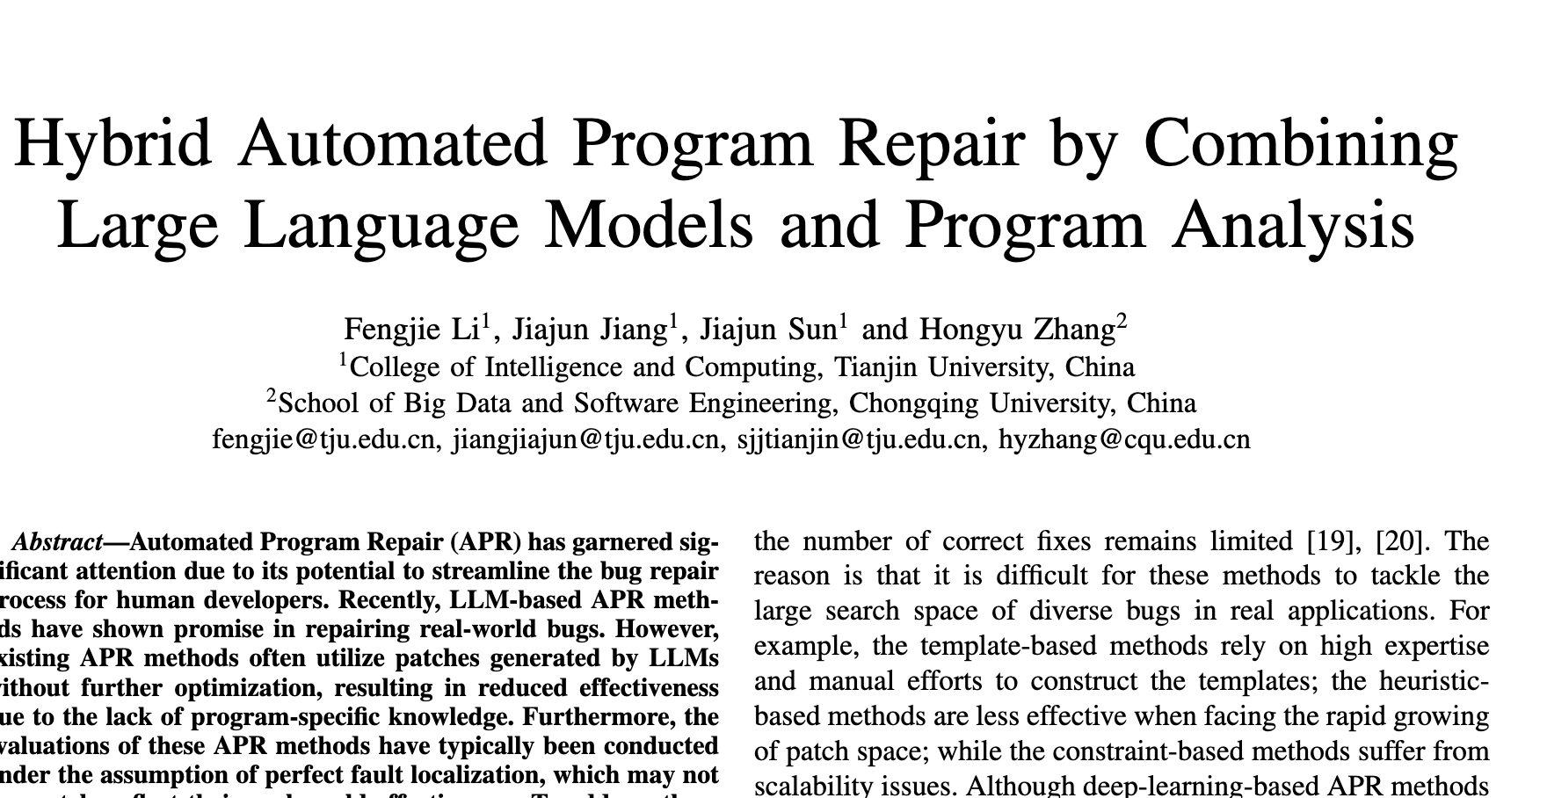
The LLM bit…

Slide 49
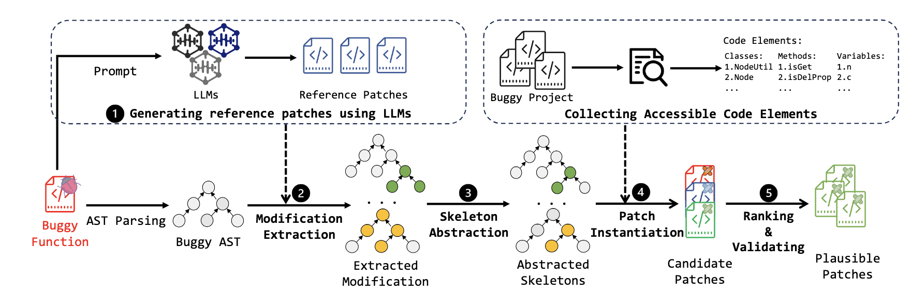
The GiantRepair approach

Slide 50
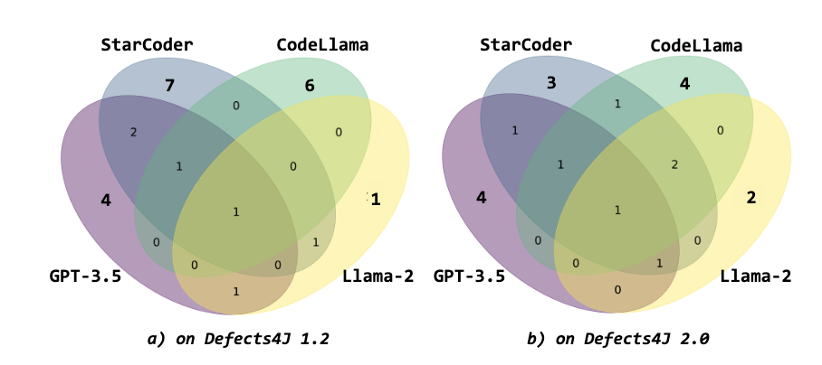

Slide 51
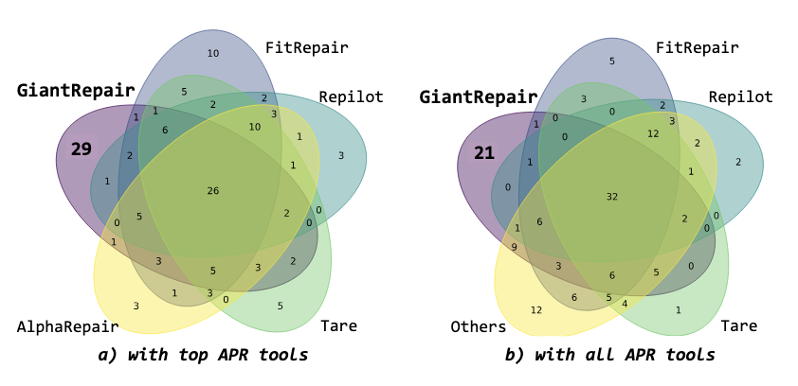

Slide 52
So What?
LLMs cannot help, yet…
Other approaches help in domain-specific fashion;
Often only used in mission-/safety-critical domains:
Formalisms are often required;
Spec must be laying somewhere!

Slide 53


Slide 54
18. References & Further Reading
• Monperrus, M. (2018). The Living Review on Automated Program Repair. HAL Id: hal-01956501
• Weimer et al. (2009). Automatically Finding Patches Using Genetic Programming.
• Mechtaev et al. (2016). Angelix: Scalable Semantics-based Program Repair.
• Le Goues et al. (2012). GenProg: A Genetic Method for Program Repair.
• Zhang et al. (2024). Self-Edit: LLM-driven Automated Code Repair.

